Slide 1
Self-Check Laboratory Exercise I (Multiplexer Design)
Anthony Ramos

Slide 2
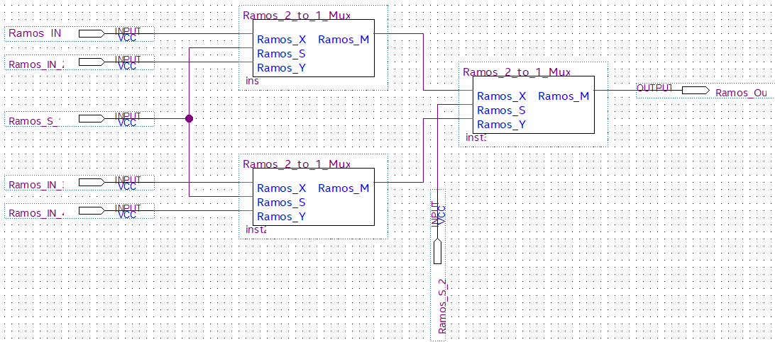
Task 1.2.1
Figure 1: 4:1 Mux block diagram using 2:1 mux symbols

Slide 3
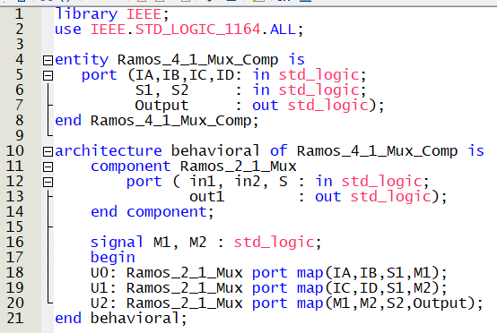
Task 1.2.2
Figure 2: VHDL code for MUX 4:1 using MUX 2:1 as a component

Slide 4
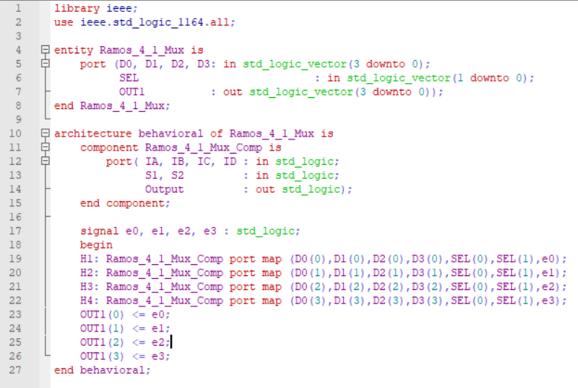
Task 1.2.3
Figure 3: VHDL code for MUX 4:1 (4-bit input)

Slide 5
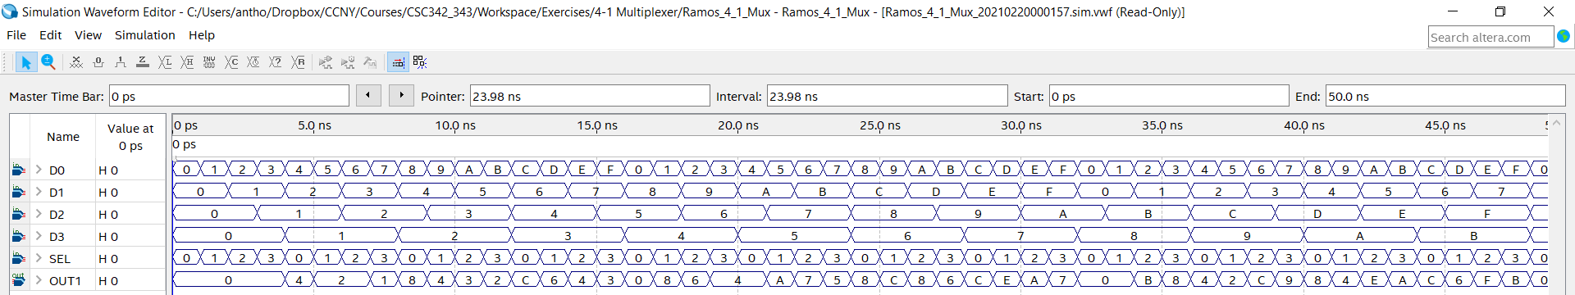
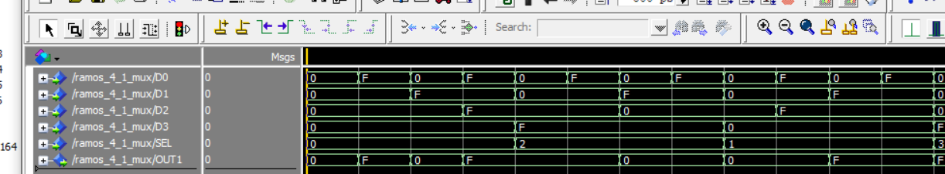
Task 1.2.3
Figure 4: Simulation output for 4-Bit 4:1 Mux

Slide 6
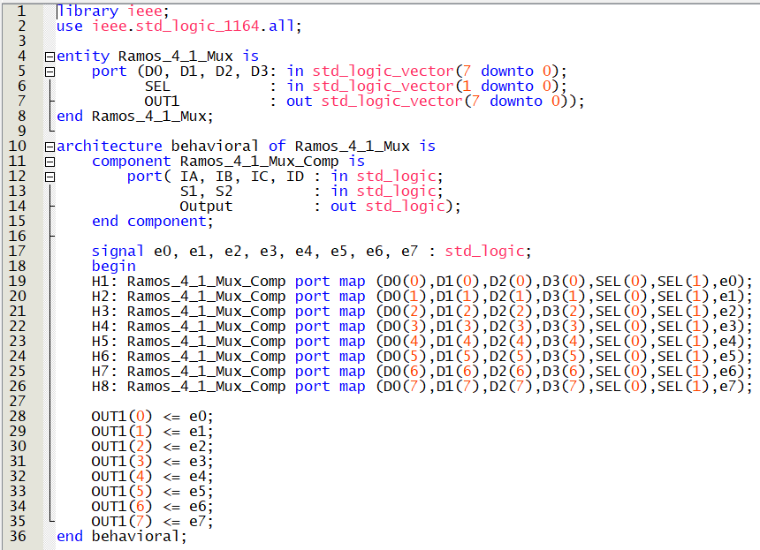
Task 1.2.4
Figure 5: VHDL code for MUX 4:1 (8-bit input)

Slide 7
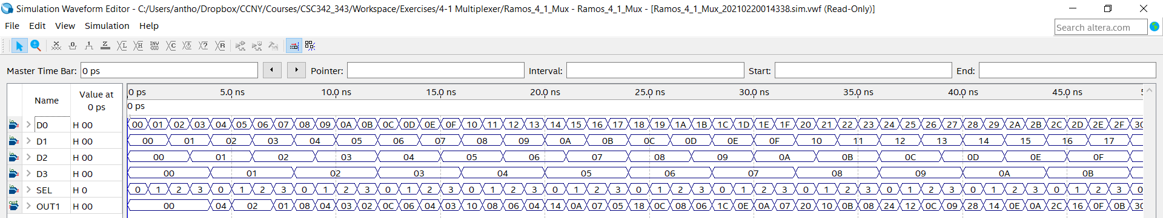
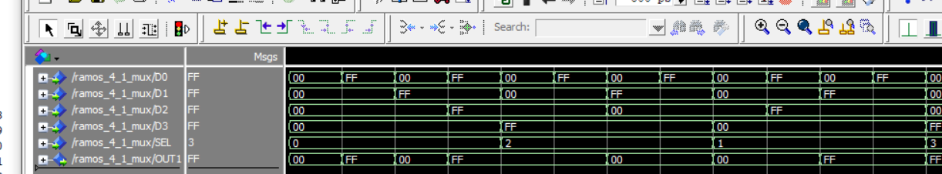
Task 1.2.4
Figure 6: Simulation output for 8-Bit 4:1 Mux

Slide 8
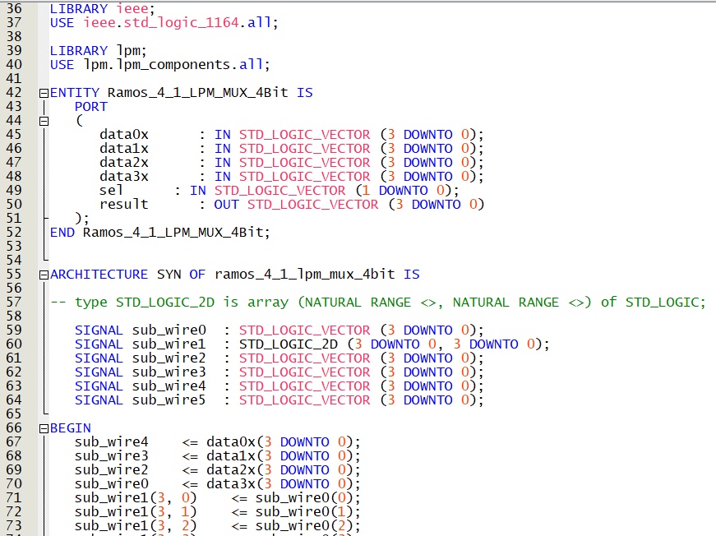
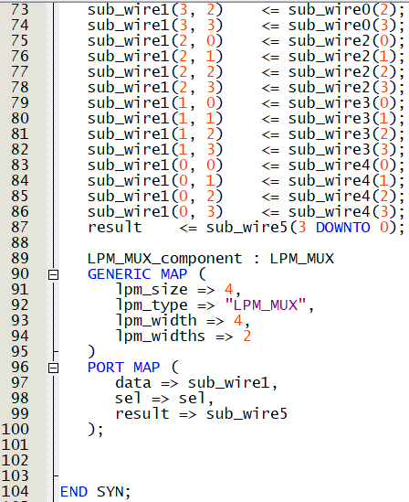
Task 1.2.5
Figure 7: VDHL code for 4-bit 4:1 Mux (LPM)

Slide 9
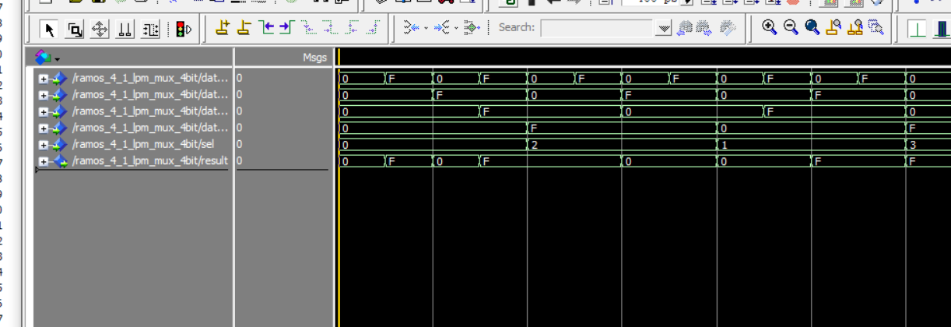
Task 1.2.5
Figure 8: Simulation Output for 4-bit 4:1 Mux (LPM)

Slide 10
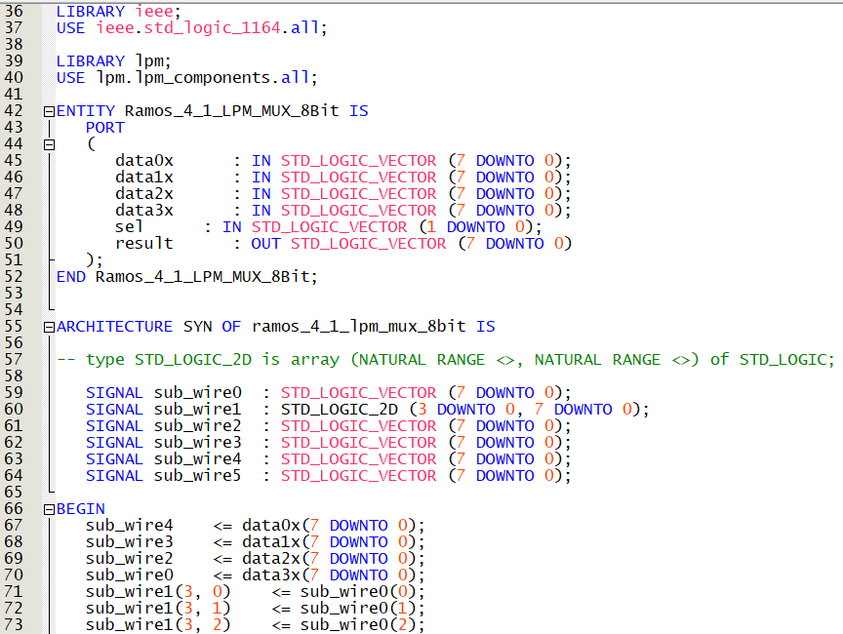
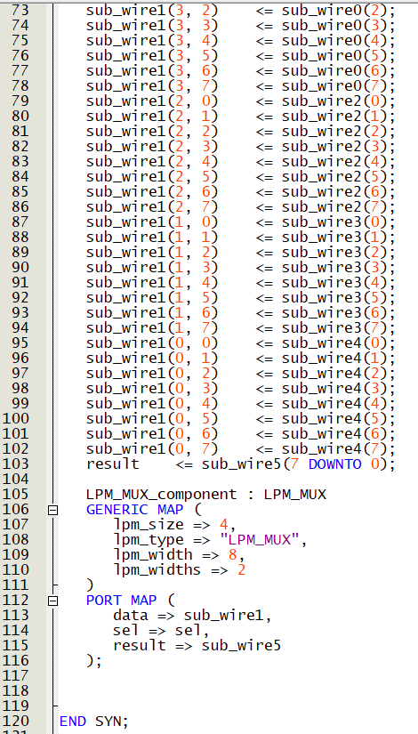
Task 1.2.5
Figure 9: VHDL Code for 8-bit 4:1 Mux (LPM)

Slide 11
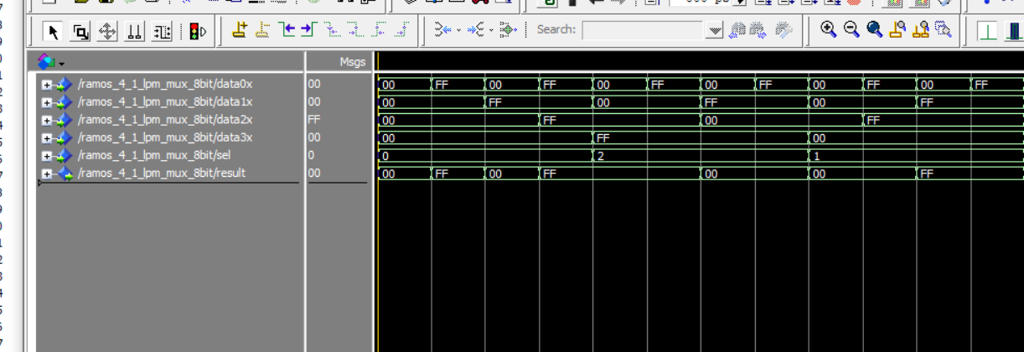
Task 1.2.6
Figure 10: Simulation Output for 8-bit 4:1 Mux (LPM)

Slide 12
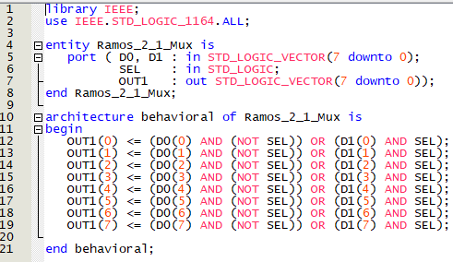
8-Bit 2:1 Mux
Figure 11: VHDL Code for 8-bit 2:1 Mux

Slide 13
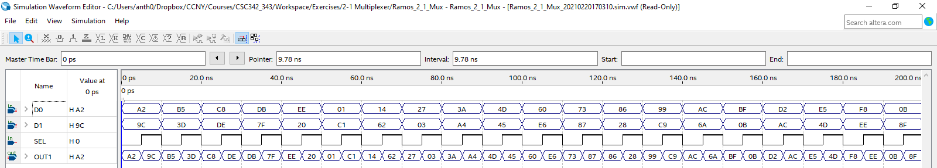
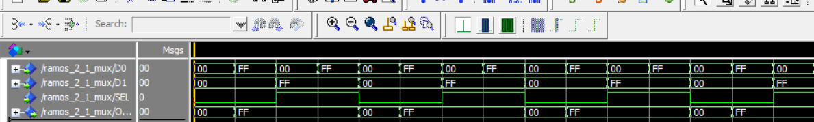
8-Bit 2:1 Mux
Figure 12: Simulation Output for 8-bit 2:1 Mux

Slide 14
Verification of Designs
The outputs of the four designs are correct because their waveforms are consistent with the truth table of a 4:1 Mux. That is, whenever the selector (SEL) is 0x01, the output (OUT1) follows the behavior of D0. Similarly, when SEL is 0x02, OUT1 follows the behavior of D1 and so on and so forth.
In terms of writing the VHDL code, it was very useful to utilize the 2:1 Mux design from the previous lab and use it as a component to design a 4:1 Mux. Of course, we could next create an 8:1 Mux using the 4:1 Mux we just designed.

